Slide 1
LUX INVICTA TIMELINE AND MAPS
Here we have projected the happenings in the alternate history of Lux Invicta, event for event, in the form of maps showing names and places.
The original timeline is entirely the work of Shaytana, the creator of Lux Invicta. Most historical events that are unreferenced by Shaytana and don’t interfere with his changes are assumed to have happened as they did in our timeline. To help explain map changes, many of these details have been added and marked with an asterisk (*).
In addition to Shaytana’s timeline, more content has been written to help mesh the world of Lux Invicta with new areas of the map. As a rule, these additions will only target events that Shaytana hasn’t already mentioned, or ones that were only briefly referenced. Original content is always preserved in its entirety whenever possible, and changes are only made when necessary.
Any changes to original content are noted with italics. Additions made to the timeline have been written in boldface.

Slide 2
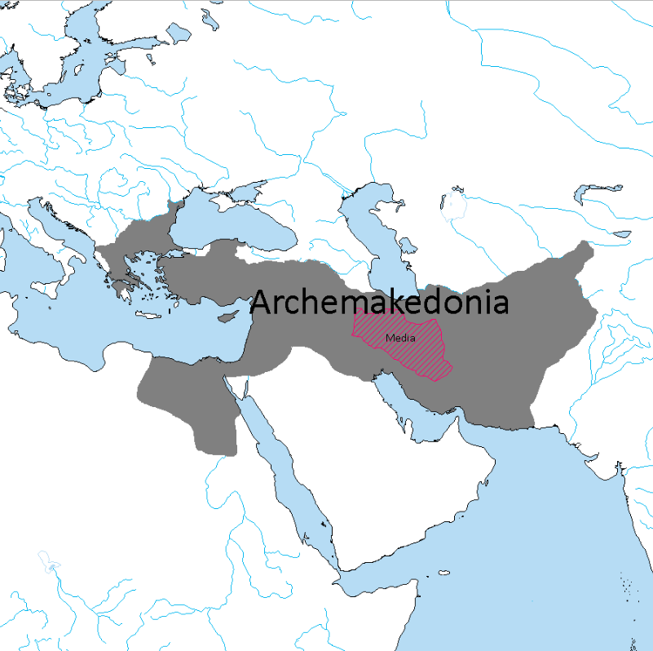
330 BCE
Megas Alexandros conquers Persia.
Beginning of implementation of policies regarding the Hellenic colonization of the East.
Parmenion is appointed Satrap of Ecbatana, his son Philotas sent to Media to oversee the creation of Hellenic military colonies in the region.

Slide 3
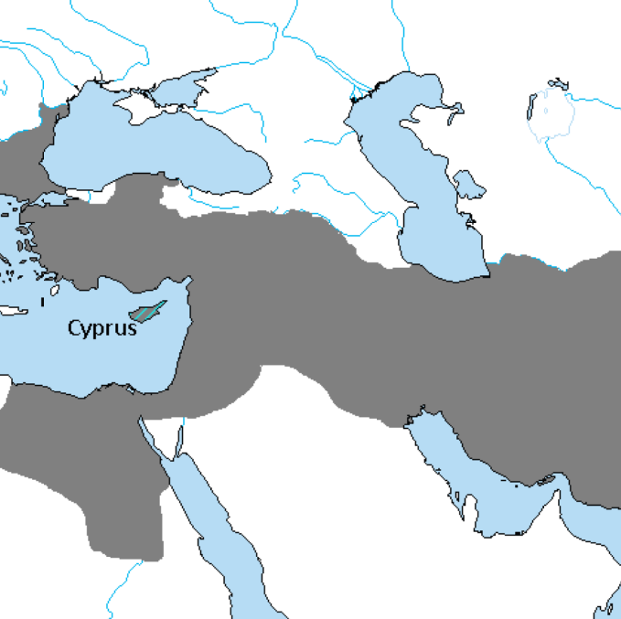
319 BCE
Megas Alexandros dies, poison is suspected to be the cause of death. He leaves behind several legitimate children by Roxana and Stateira, and several illegitimate ones widely acknowledged to be his.
His son Alexandros IV is blinded in an accident and following unrest he is taken by his mother and loyal retainers to Cyprus.

Slide 4
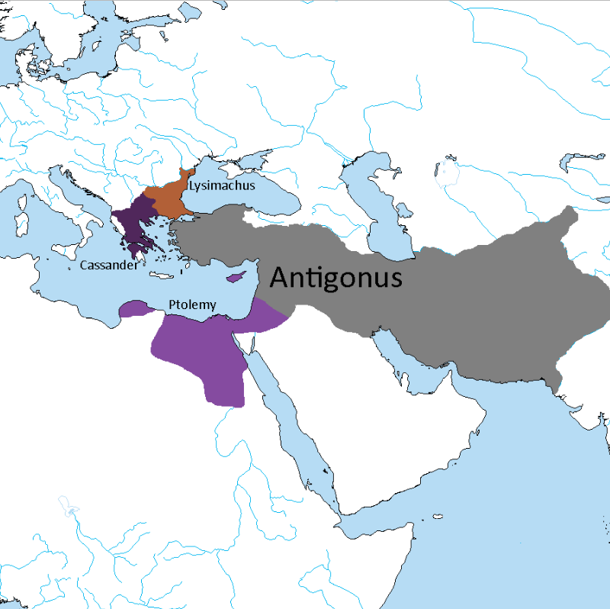
318 BCE
Diadokhoi Crisis starts in earnest.
Beginning of the division of the empire.

Slide 5
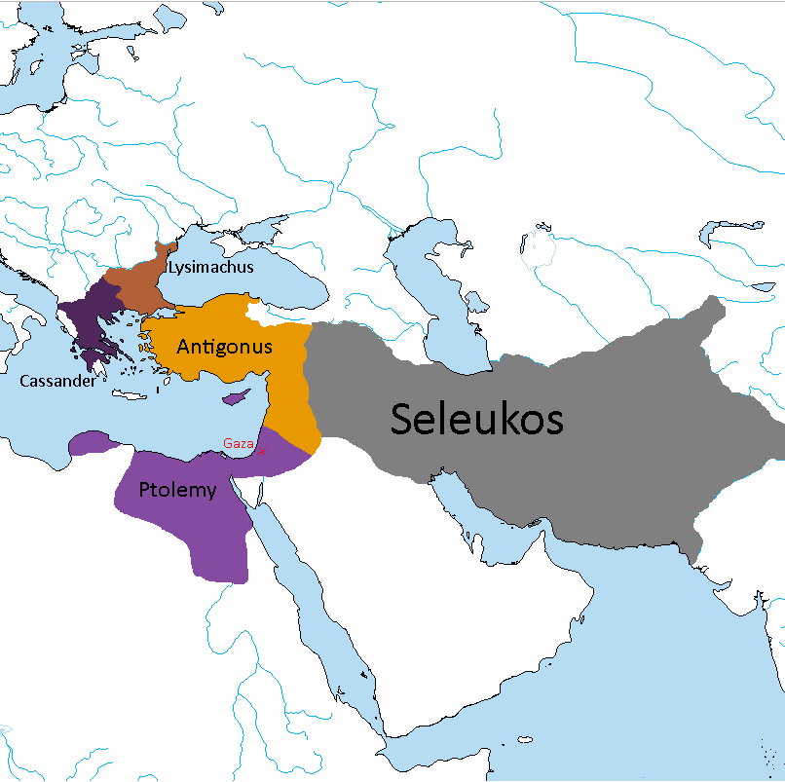
312 BCE
Seleukos I Nikator and Ptolemy I Soter defeat Demetrius I Poliorcetes of Makedon in the Battle of Gaza.
Beginning of Seleukid Era and creation of Arche Seleukeia.
*Demetrius I is the son of Antigonus.

Slide 6
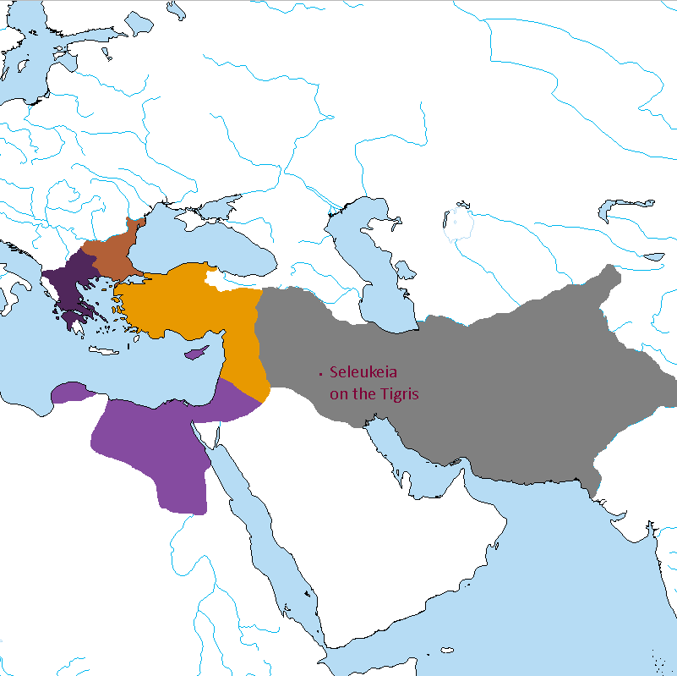
305 BCE
Seleukos I Nikator founds Seleukeia on the Tigris, his new capital.

Slide 7
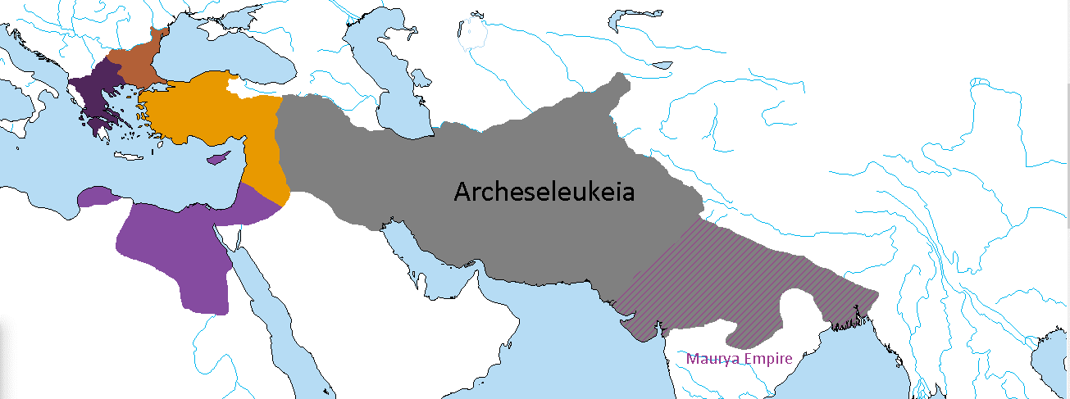
303 BCE
Seleukid Conquest of Sindhia.
Chandragupta Maurya becomes a Seleukid vassal.

Slide 8
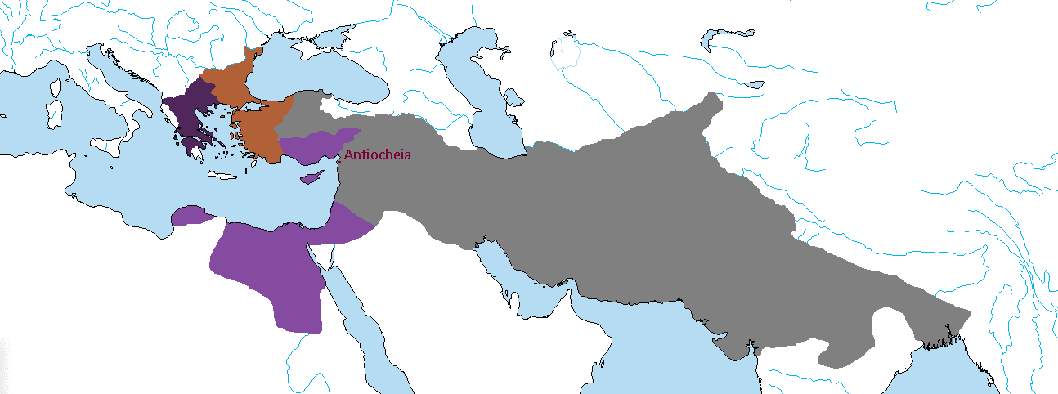
*Although he goes entirely unreferenced, Antigonus dies in 301 BCE at the Battle of Ipsos. Lysimachus receives the Aegean cost, while Seleukos and Ptolemy divide the rest of Asia Minor and Syria.
300 BCE
Founding of Antiocheia by Seleukos I Nikator, western capital of the empire.

Slide 9
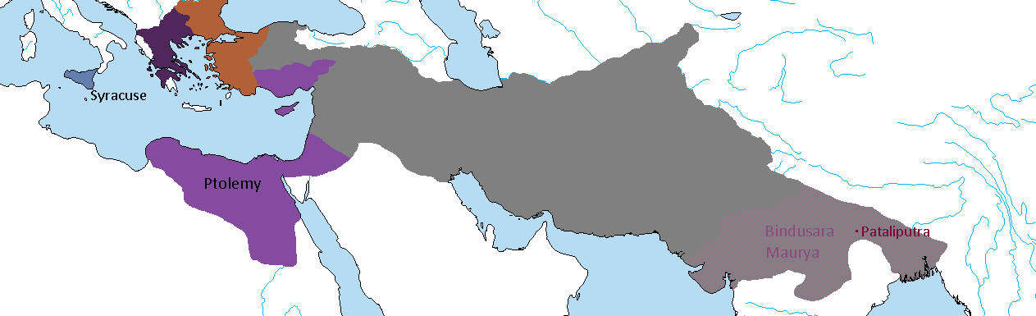
298 BCE
The Hieronid Agathocles of Syracuse unifies Sicily under his rule and marries Ptolemy's stepdaughter Theoxena.
Kyrene is brought under Ptolemaic control.
Chandragupta abdicates his throne to his son Bindusara and spends his final days in sallekhana (fasting to death) in a cave, according to the Jain tradition.

Slide 10
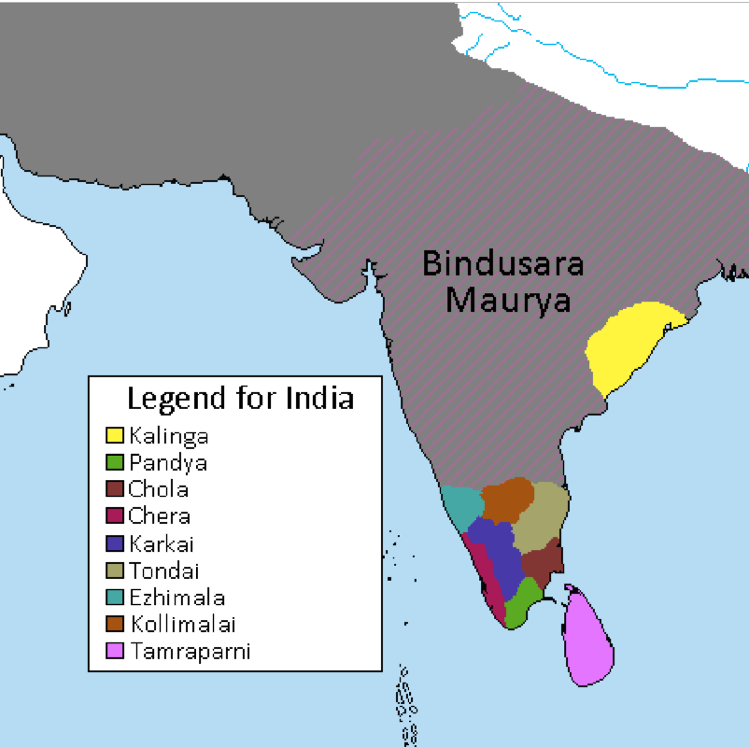
297 BCE
Bindusara expands the Mauryan Empire south into Deccan but decides not to conquer the entire peninsula in exchange for a wealthy tribute from the Tamil kingdoms.
*As in our timeline, he tried but was unsuccessful in conquering Kalinga.

Slide 11
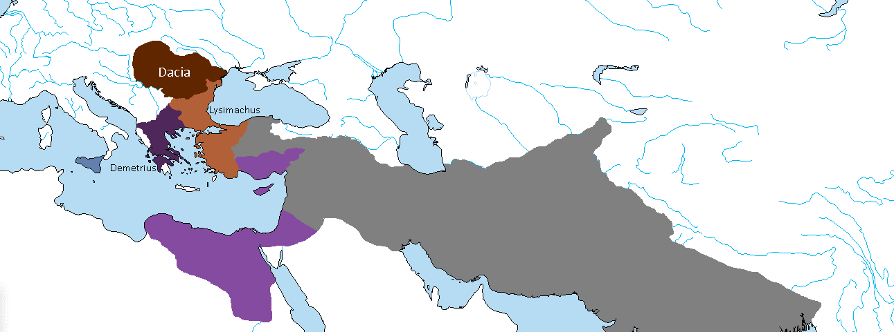
292 BCE
Lysimachus, Basileus of Thrakia campaigns beyond the Danube, but he is defeated and taken prisoner by the Dacian king Dromichaetes. Lysimachus is set free after the marriage of Dromichaetes with Lysimachus' daughter.
Hellenic influence over Dacia increases.
*Demetrius I has become King of Makedon by now.

Slide 12
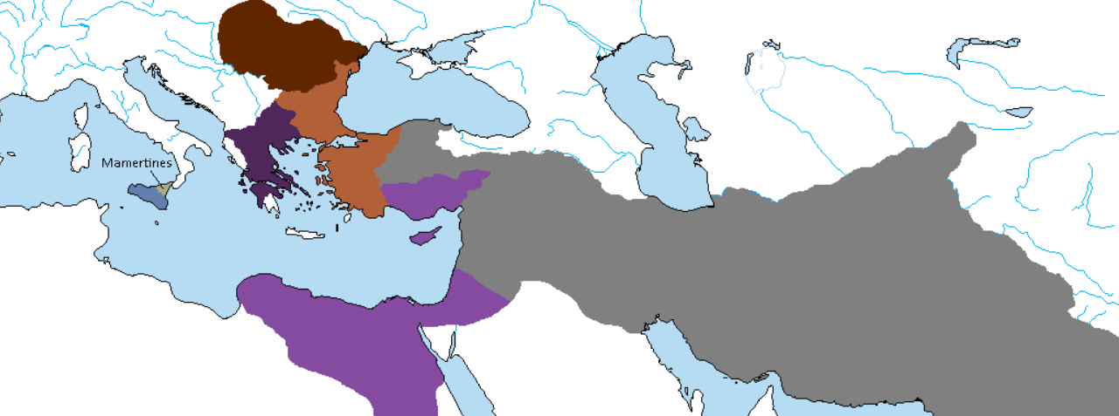
289 BCE
Agathocles of Syracuse dies, and a succession struggle ensues.
Mercenaries calling themselves Mamertines (“Sons of Mars”) take over Messana and the northeastern part of the island.

Slide 13
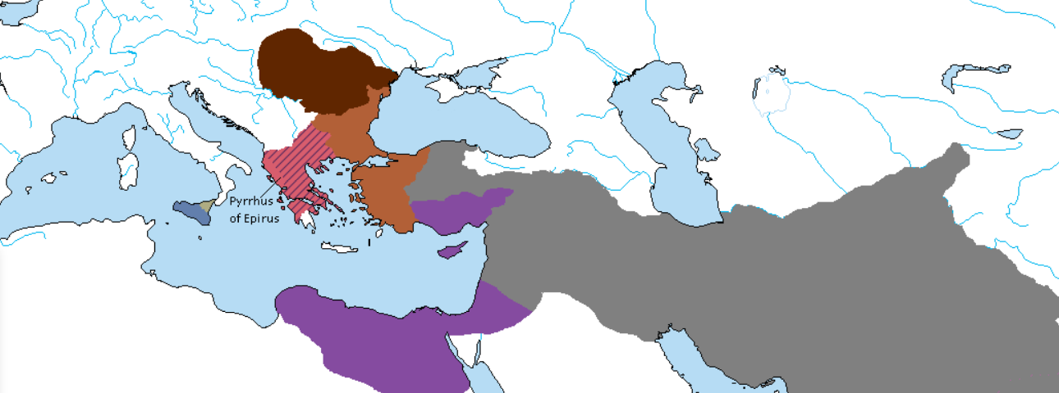
287 BCE
Pyrrhus defeats Demetrius I Poliorcetes and is proclaimed King of Makedon.

Slide 14
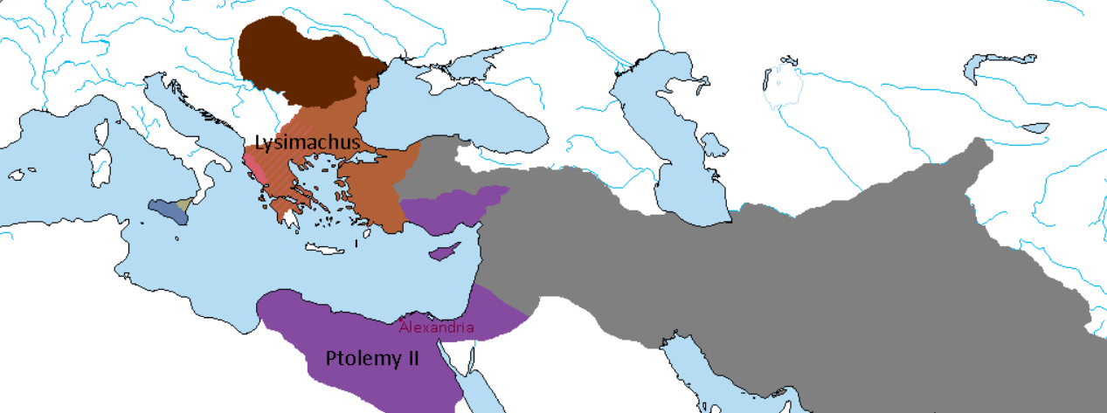
285 BCE
Ptolemy I Soter abdicates in favor of his son Ptolemy II Philadelphos. The Pharos of Alexandria is completed.
Pyrrhus is driven out of Makedon by Lysimachus with Dacian help.

Slide 15
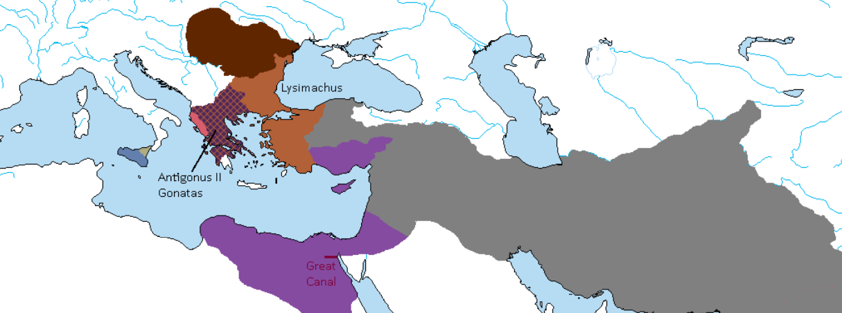
283 BCE
Antigonus, son of Demetrius I Poliorcetes becomes King of Makedon in name only as Lysimachus controls the Kingdom.
The Great Canal between the Red Sea and the Nile is reopened by Ptolemy II Philadelphos.

Slide 16
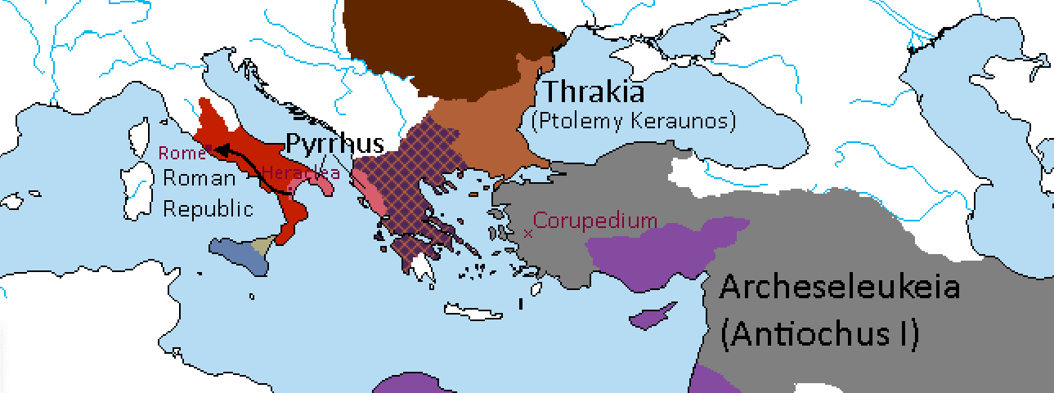
*Ptolemy Keraunos goes on to succeed Lysimachus in Thrakia.
281 BCE
Battle of Corupedium: Seleukos kills Lysimachus in battle but is assassinated by Ptolemy Keraunos. He is succeeded by his son Antiochus.
Pyrrhus defeats the Romans at Heraclea and goes on to besiege Rome itself.

Slide 17
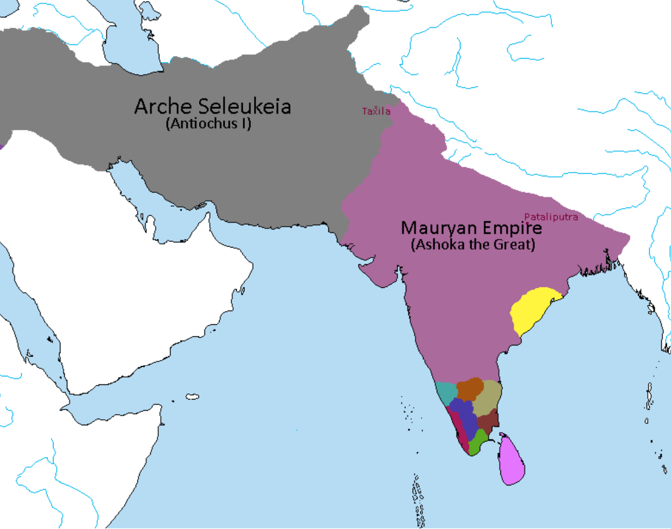
280 BCE
Beginning of the Mauryan Rebellion against Seleukid control in Sindhia.
Bindusara is killed in the Battle of Taxila. His son Ashoka is coronated in Pataliputra.

Slide 18
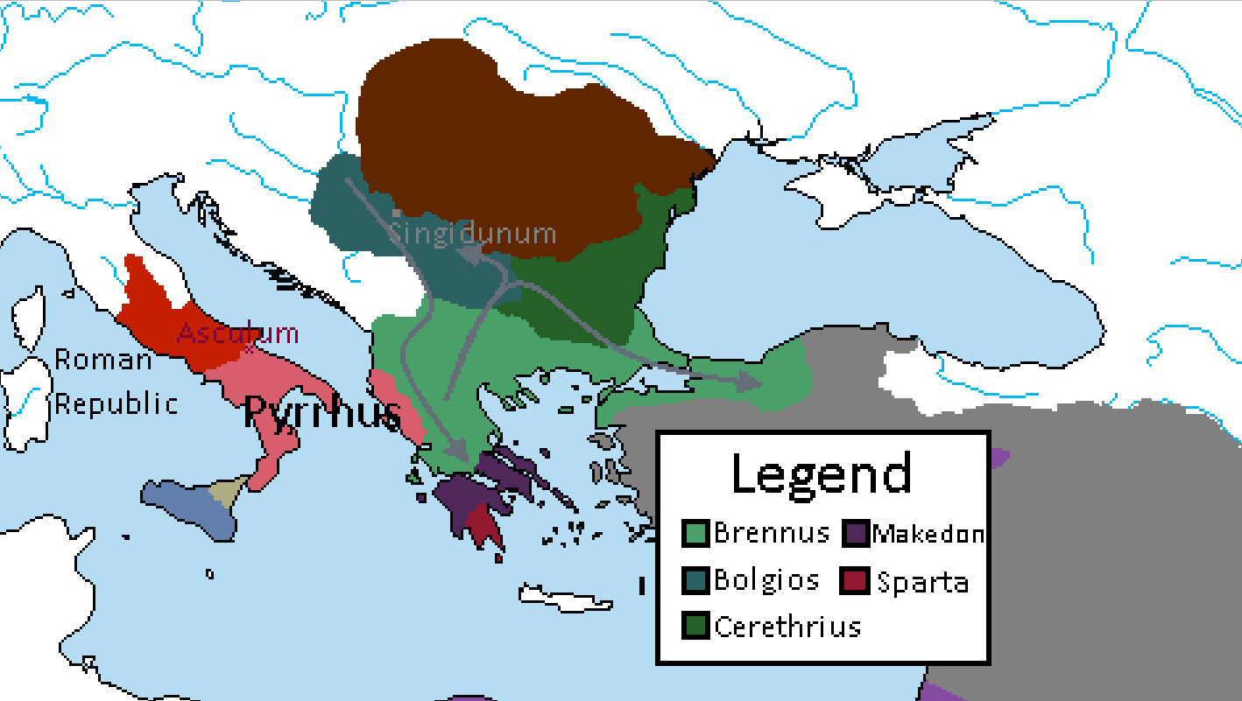
279 BCE
A Celtic army under Brennus invades Greece. They defeat a Makedonian army under Ptolemy Keraunos, but the Spartans temporarily hold Brennus at Thermopylae. Brennus retreats to the north only to defeat the pursuing Spartans in a battle near Mount Othrys. He then presses on and conquers Delphi, before retreating northwards.
The Celtic hosts splits, and a Celtic Kingdom of Tylis is founded under Cerethrius. Part of the host moves northwards to establish a kingdom in Pannonia, under Bolgios. Celtic Singidunum is founded. Brennus crosses the Hellespont and overruns Bithynia.
Pyrrhus defeats the Romans at Asculum. Peace is negotiated, with Rome acknowledging his dominion over Magna Graecia.
* ”Makedon” here is simply a term for Antigonus II Gonatas’ rump state in Greece. He is not presently recognized as a king, though he does still “wear the purple”.

Slide 19
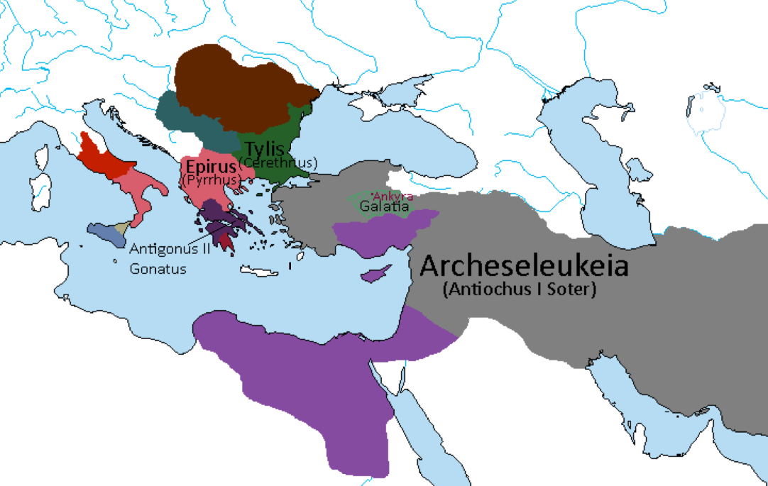
278 BCE
Brennus is defeated by Antiochus Soter near Ankyra. He acknowledges Seleukid sovereignty, and the majority of his Celts are settled in Galatia; many of the Celtic warriors take up service with the Seleukid Basileus.
Beginning of Seleukid policy of establishment of Celtic military colonies, from Asia minor to Bactria and Sindhia.
* No historical or canon references to Seleukid gains in Europe. Antigonus II historically regains his lands before losing most of them to Pyrrhus.

Slide 20
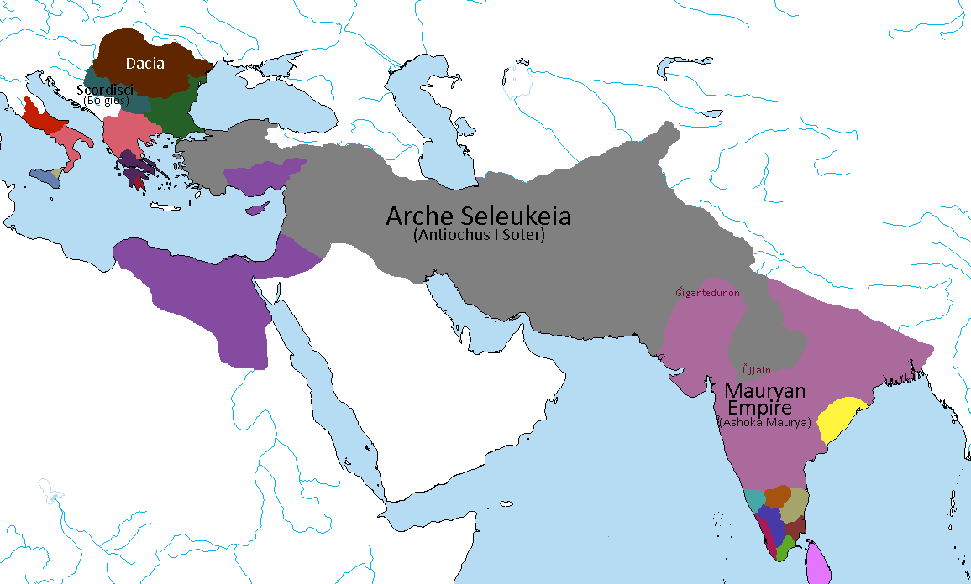
277 BCE
Daco-Celtic War, following Scordisci invasion of Dacia. Defeated, Bolgios King of the Scordisci marries Darava, the daughter of the Dacian King and retires to Singidunum. Beginning of the Daco-Celtic alliance.
Seleukid victory at the Battle of Ujjain, though a pyrrhic victory at that. Antiochus I Soter reaches Sindhia with his army composed of Hellenic and Celtic troops. Celtic town of Gigantedunon (“stronghold of giants”) founded across from Alexandria on the Indus.

Slide 21
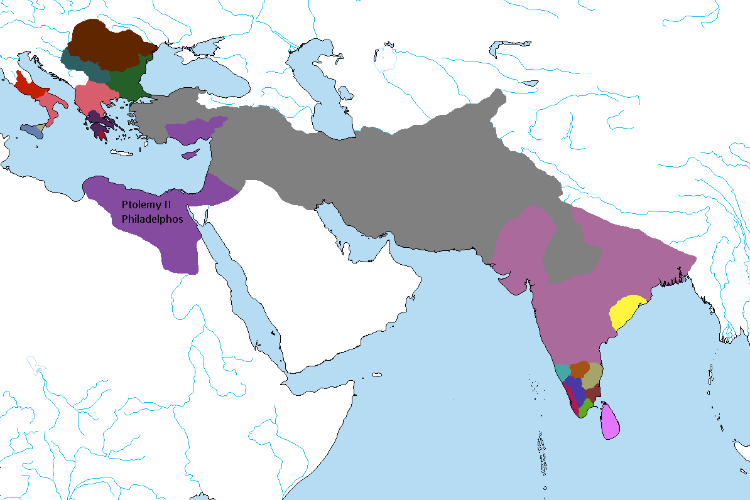
276 BCE
Ptolemy II marries his own sister Arsinoe. They become known as Philadelphoi (“sibling-lovers”).

Slide 22
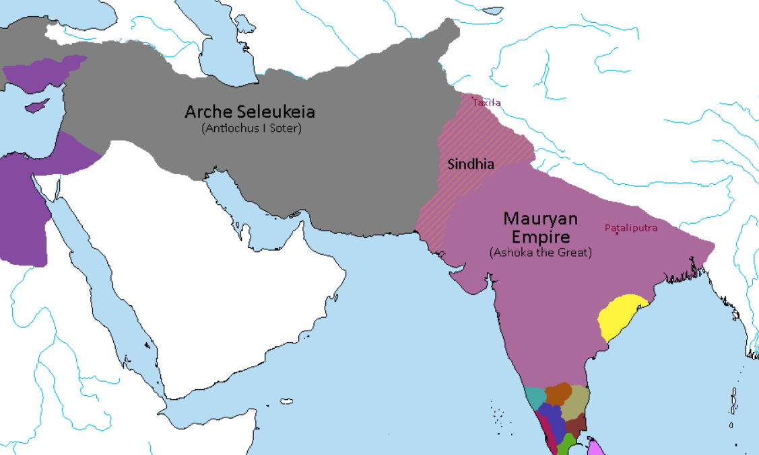
273 BCE
In exchange for land and titles in the Indus Valley, a handful of Seleukid generals defect to the Mauryan army in secret. They wait for a major battle to show their treason.
Ashoka the Great defeats the Seleukids in battle near Pataliputra.
Following the Treaty of Taxila, the “Great Satrapy of Sindhia” becomes subject to his direct rule. He marries the Seleukid princess Olympia as part of the peace negotiations.
CHANGES: Shaytana had written that Ashoka was already Satrap of Sindhia, and that “Eastern Sindhia” became quasi-independent. This implies the Mauryan Rebellion wasn’t already in progress, and that Sindhia had been divided. To alleviate confusion, I changed Ashoka’s title before the treaty but kept the result the same: one Sindhia, ruled by Ashoka.

Slide 23
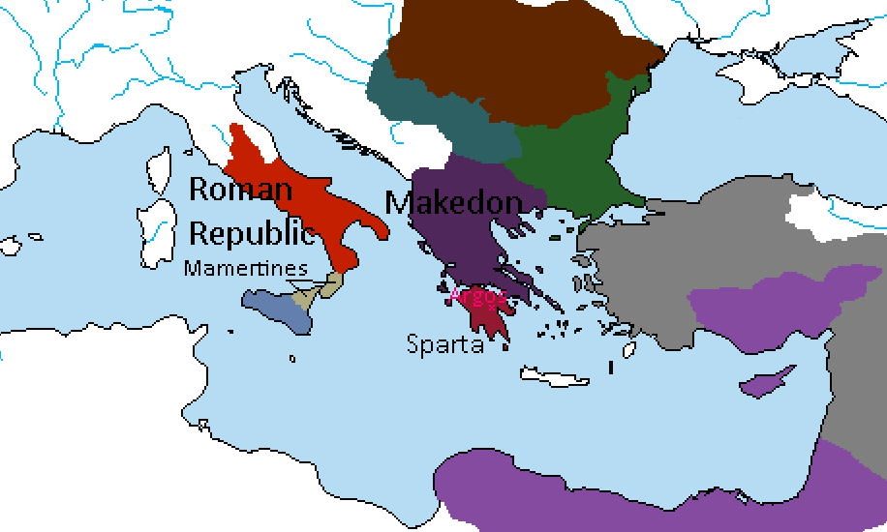
272 BCE
The Spartans under Areus I defeat Pyrrhus at the Battle of Argos, and Pyrrhus is killed.
Areus I is proclaimed King of the Hellenes, while Antigonus II Gonatas manages to regain the Makedonian throne.
Following the Treaty of Corinth Antigonus II is acknowledged as King of Makedonia, while Sparta retains the entire Peloponnesus.
*Epirus is absorbed into Makedon, while most of Pyrrhus’ holdings in Italy surrender to Rome. The Mamertines claim Rhegium and the Brutii region at the end of the peninsula.

Slide 24
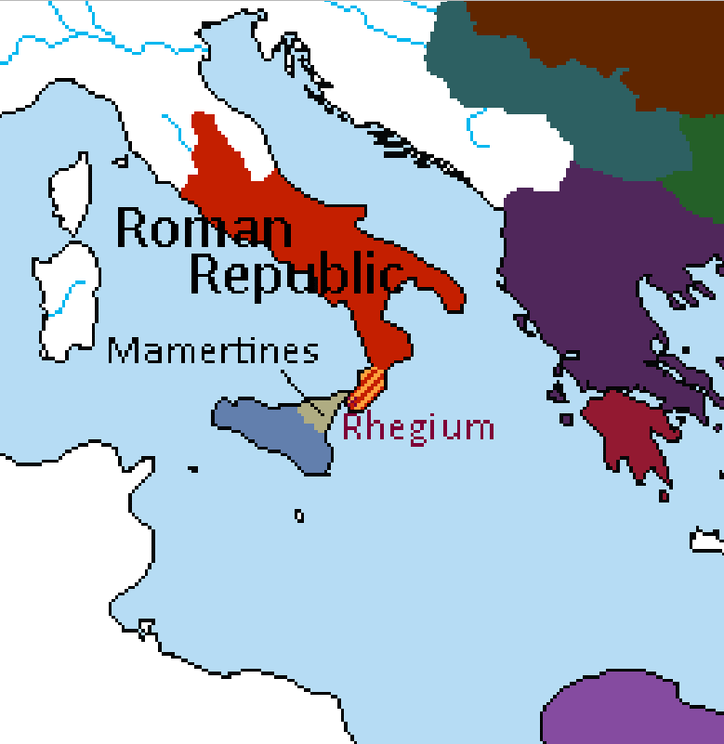
270 BCE
Romans drive out the Mamertines from Rhegium and restore it to its Greek citizens.
Mamertines retreat to Sicily.
*When Rome restores Rhegium “to its Greek citizens”, this is interpreted more culturally than politically. Whoever is ruling the city directly would ultimately be subject to Rome after this event.

Slide 25
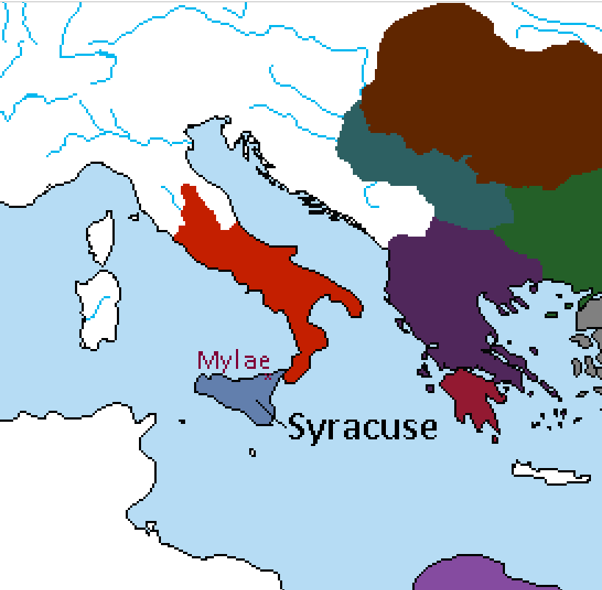
269 BCE
Hieron II of Syracuse defeats the Mamertines near Mylae. The defeated Mamertines accept his sovereignty and Hieron II becomes king of the entire island.

Slide 26
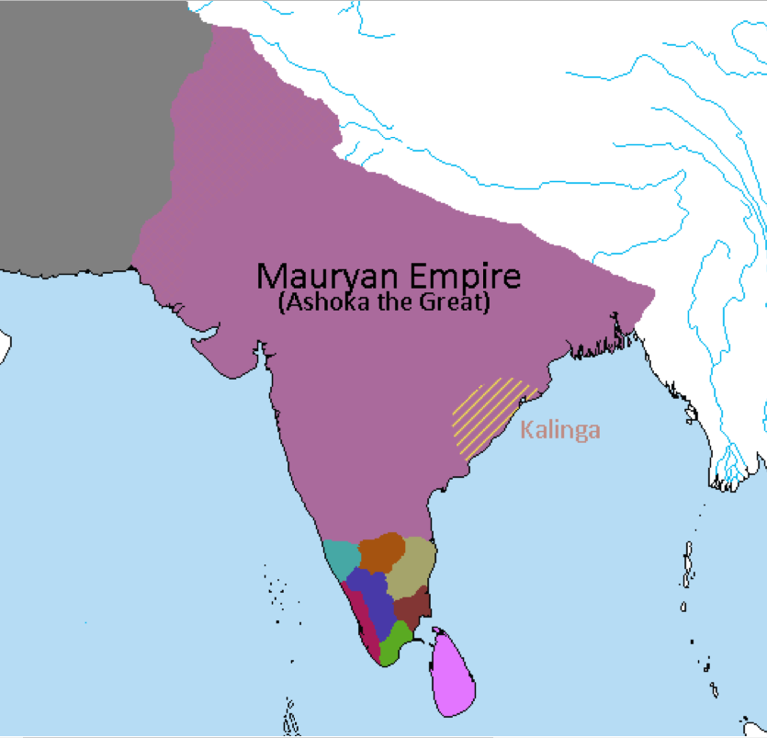
265 BCE
Kalinga is conquered by Ashoka the Great.
Ashoka is mortified by the death toll after the Battle of Kalinga. Over one hundred thousand lay dead and the rivers ran red with blood. Ashoka embraces Buddhism and begins a more peaceful, benevolent reign.

Slide 27
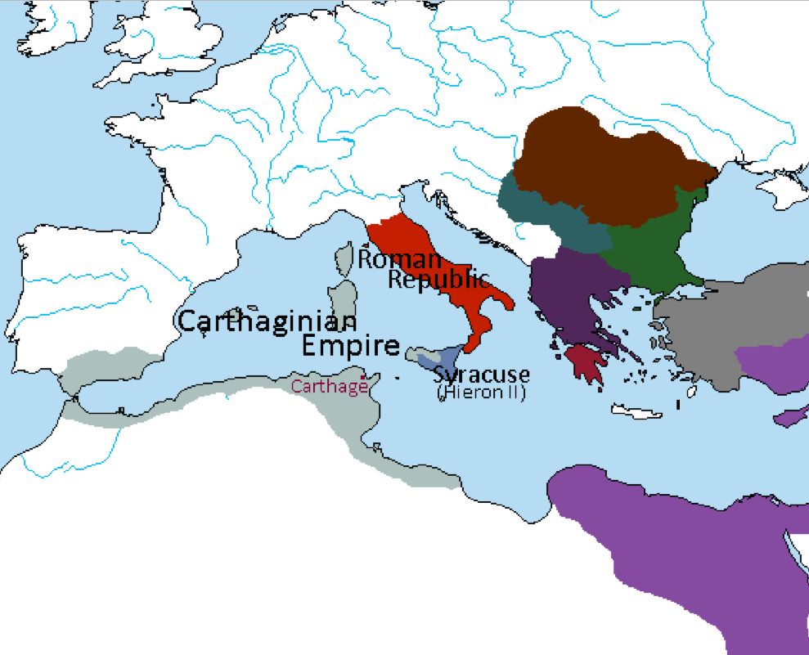
264 BCE
Carthaginians invade Sicily. Hieron II asks for Roman support.
Beginning of First Punic War. Hieron II acknowledged as King of Sicily by the Romans. Beginning of the Roman-Syracusan Alliance.
*By now, Rome has conquered the Etruscans and has most of the Italian peninsula under its control.

Slide 28
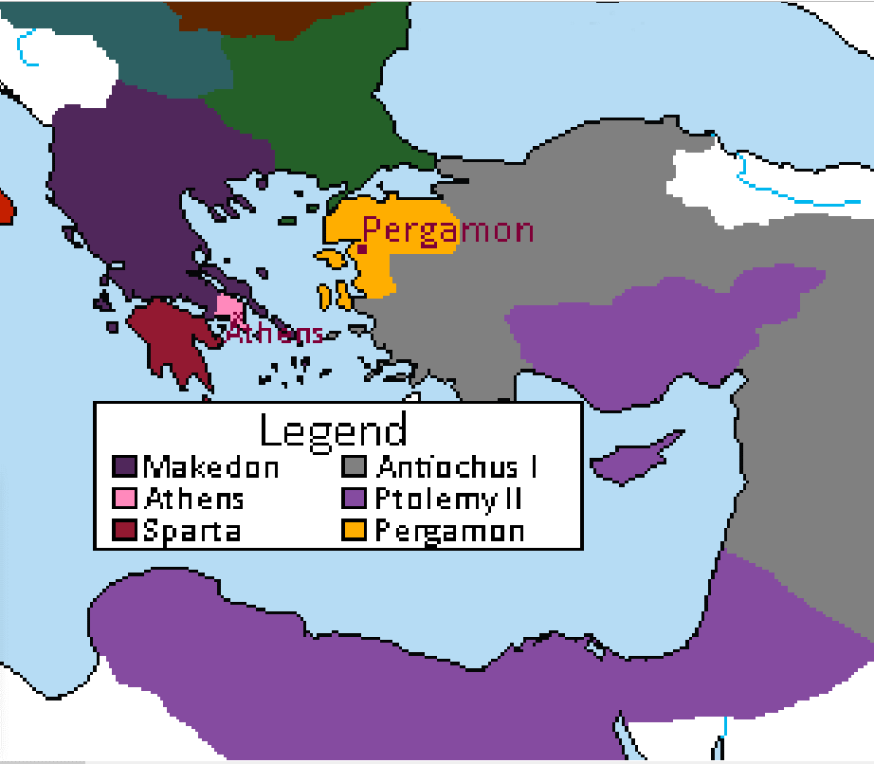
262 BCE
Supported by the Ptolemaic navy and army, Athens rebels.
Antigonus tries to besiege the city but is defeated and forced to acknowledge an independent Athenian state.
Eumenes I of Pergamon defeats Antiochus and founds an independent kingdom.

Slide 29
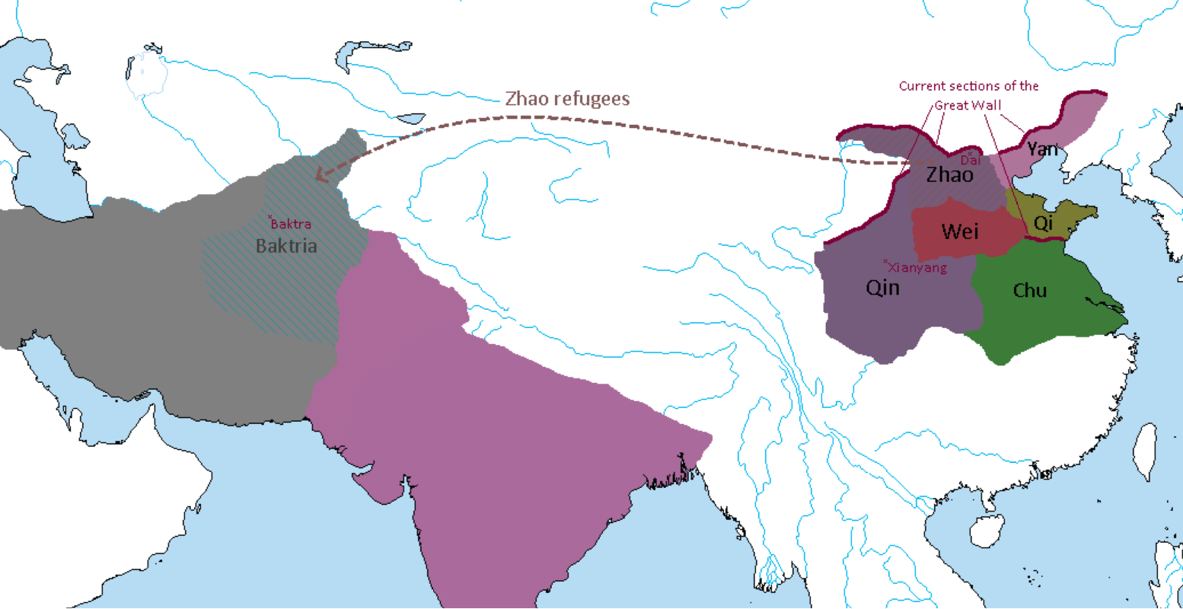
260 BCE
Qin overruns the state of Zhao.
The Great Western Exodus follows with several hundred thousand Zhao citizens migrating west, eventually settling in Central Asia and Baktria where they become Hellenic subjects.

Slide 30
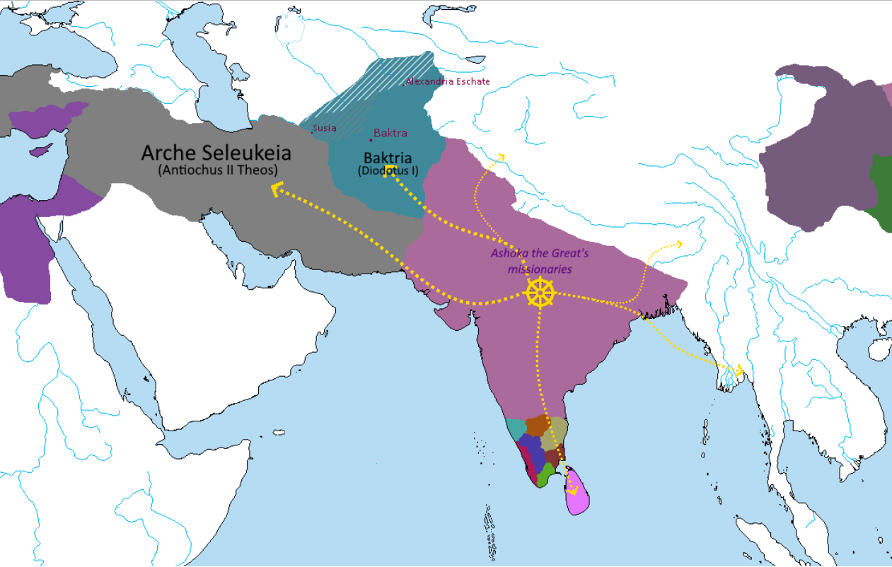
255 BCE
Diodotus, Satrap of Baktria, rebels and establishes an independent kingdom. His dominions are expanded with the help of the Zhao refugees and Galatian military colonies.
Ashoka the Great sends Buddhist missionaries in all directions, particularly towards the Hellenistic satrapies in the west.
Buddhism starts to become the dominant faith of India.
*Sri Lanka is the main hotbed of Buddhism in the south of India. Most of Tamilakam keeps their Brahmanical beliefs, although several Buddhist stupas and viharas are erected there.
**In the Far East, Qin has grown slightly; the Warring States period in Lux Invicta happens earlier than it does in our timeline.

Slide 31
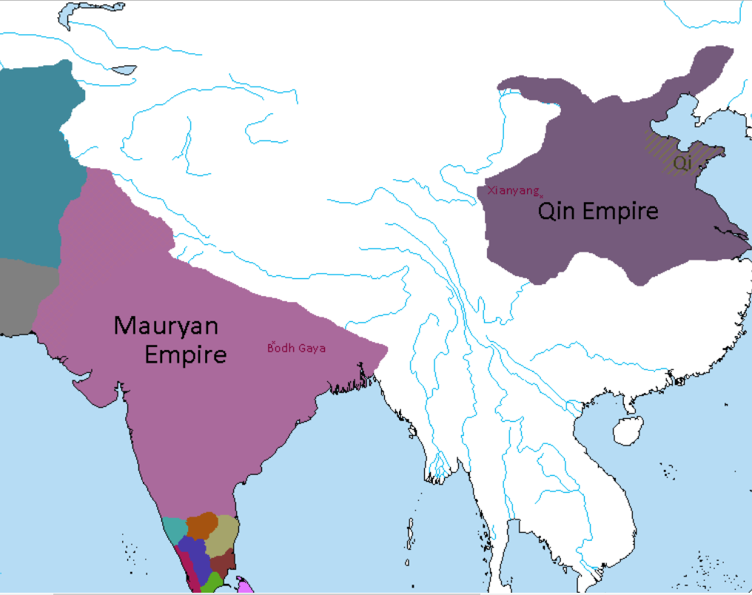
250 BCE
Ashoka the Great constructs a temple and the Diamond Throne at Bodh Gaya where the Buddha was said to have attained enlightenment.
The nine-year-old King Zheng of Qin accepts the unconditional surrender of Qi, completing the unification of China. He is coronated Qin Shi Huang (“First Emperor of Qin”) in his capital of Xianyang.
End of the Warring States period and beginning of the Qin dynasty.
*For age-related reasons, Qin Shi Huang did not conquer the other states on his own – though he did study closely under his regent Lü Buwei.

Slide 32
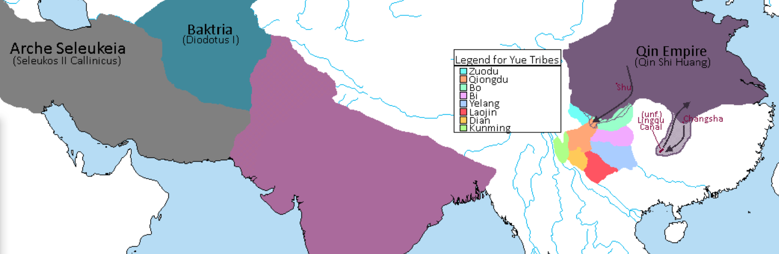

246 BCE
Diodotus marries the sister of Seleukos II Callinicus as his dominion over Baktria is confirmed.
Qin Shi Huang attempts to invade the Yue tribes south of Sichuan but suffers heavy losses against the guerrilla tactics used by the Yue soldiers.
Qin eventually withdraws, but not before beginning construction of a canal connecting the Yellow and Pearl river systems.
*Qin makes minor gains in Sichuan which they keep.
**The tribes in the area of the Lingqu Canal are not a unified kingdom yet, but this will eventually happen with the Nanyue during the Han dynasty.

Slide 33
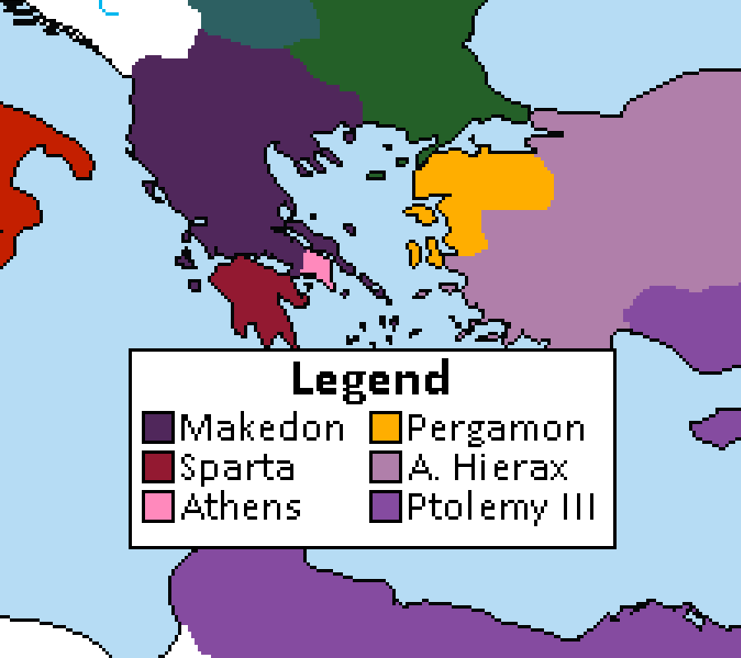
*Ptolemy II lost lands in Asia Minor to the Seleukids in the Second Syrian War. He also died in 246 BCE and was succeeded by Ptolemy III Euergetes without incident.
**While Seleukos II was occupied fighting Ptolemy, his brother Antiochus Hierax declares himself King of Syria in 245 BCE and claims Asia Minor for himself. Seleukos II has no choice but to accept… for now.
243 BCE
Agis IV reforms the Spartan state under a new Lycurgan model. The entire Peloponnesus is turned into a militaristic state, with all Hellens gaining citizenship and with all young men being enrolled into the new Agoge system.
A defensive alliance is formed with the Athenians against potential Makedonian invasion.

Slide 34
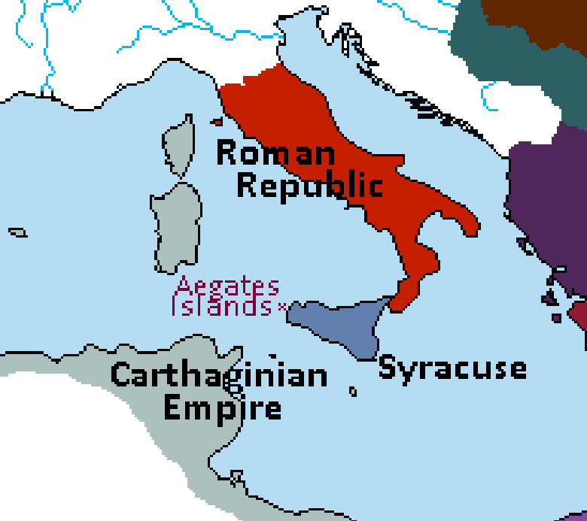
241 BCE
Carthage is defeated by the Roman-Syracusan alliance in the Battle of the Aegates Islands.
The First Punic War ends, Carthage renouncing all its claims on Sicily. Syracusan dominion of Sicily is confirmed.
An Eternal Alliance Treaty is signed between Rome and Syracuse, and a Roman legion (supported by Syracusan taxes) is stationed in Sicily.

Slide 35
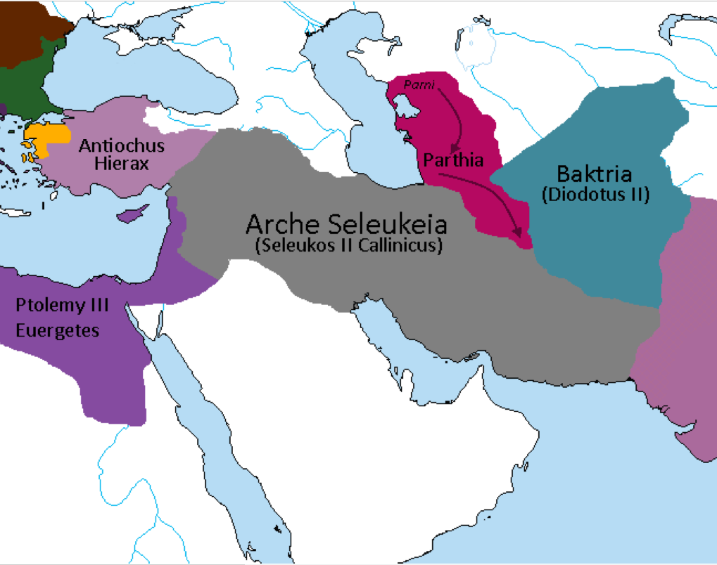
237 BCE
The Parni King Arsaces invades and conquers the Seleukid Satrapy of Parthia.
Seleukos II Callinicus is taken prisoner.
*It also stands to mention that Ptolemaioi made gains against the Seleukids in the Third Syrian War, retaining Ephesos and Seleukeia Pieria near Antiocheia. This will ultimately be the main cause of the Fourth Syrian War in 219 BCE.

Slide 36
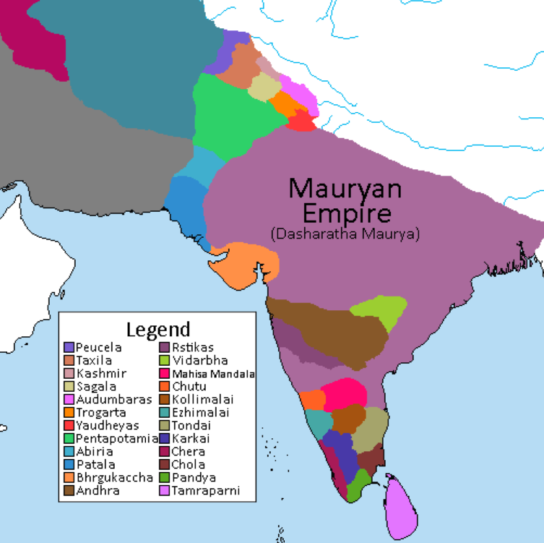
232 BCE
Ashoka the Great is ambushed by Hindu fanatics and drowned in the Ganges River.
The empire falls into chaos as several kings in central and southern India and all the Hellenic satraps in Sindhia declare independence. His son and heir Dasharatha struggles to restore order.

Slide 37
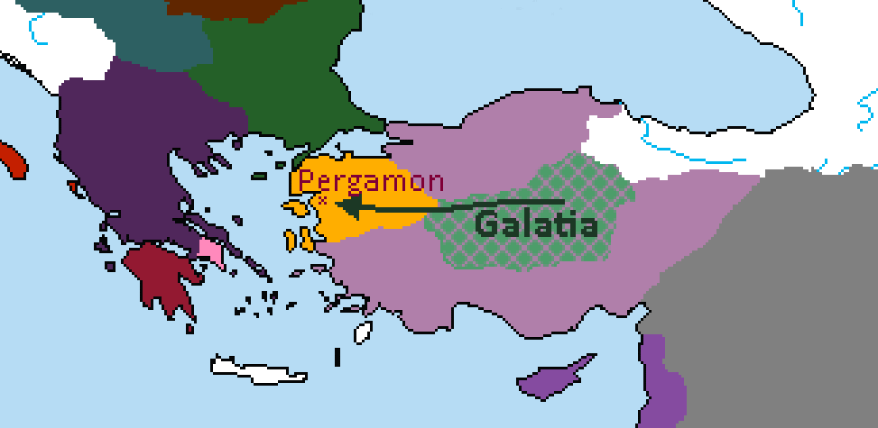
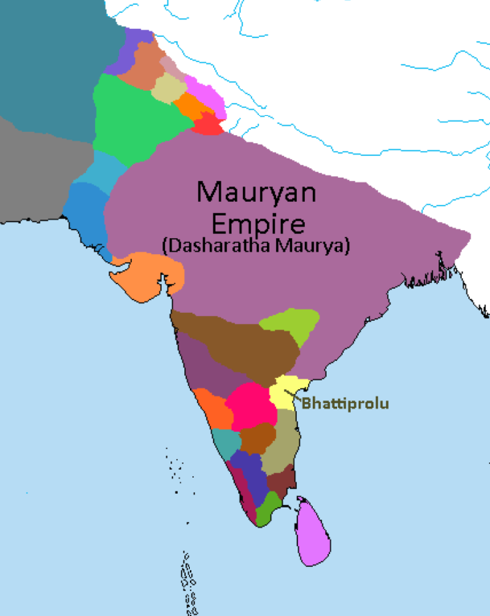
*In Egypt, Ptolemy III builds the Temple of Horus, boosting the influence of ancient Egyptian religion within his empire.
**The Roman navy occupies the island of Corfu in an effort to curb Illyrian piracy on their trade fleets. This does not result in war with Makedon, as the island had been previously taken by Illyrian pirates and its Greek inhabitants expelled.
230 BCE
Attalus I Soter of Pergamon defeats the Galatian invasion of Pergamon. He marries the Galatian princess Berena and an alliance is formed between the Galatians and Pergamon.
King Kubera of Bhattiprolu joins the rebellion against the Maurya. The resulting geographic isolation allows rebel factions to consolidate power in Karnataka.

Slide 38
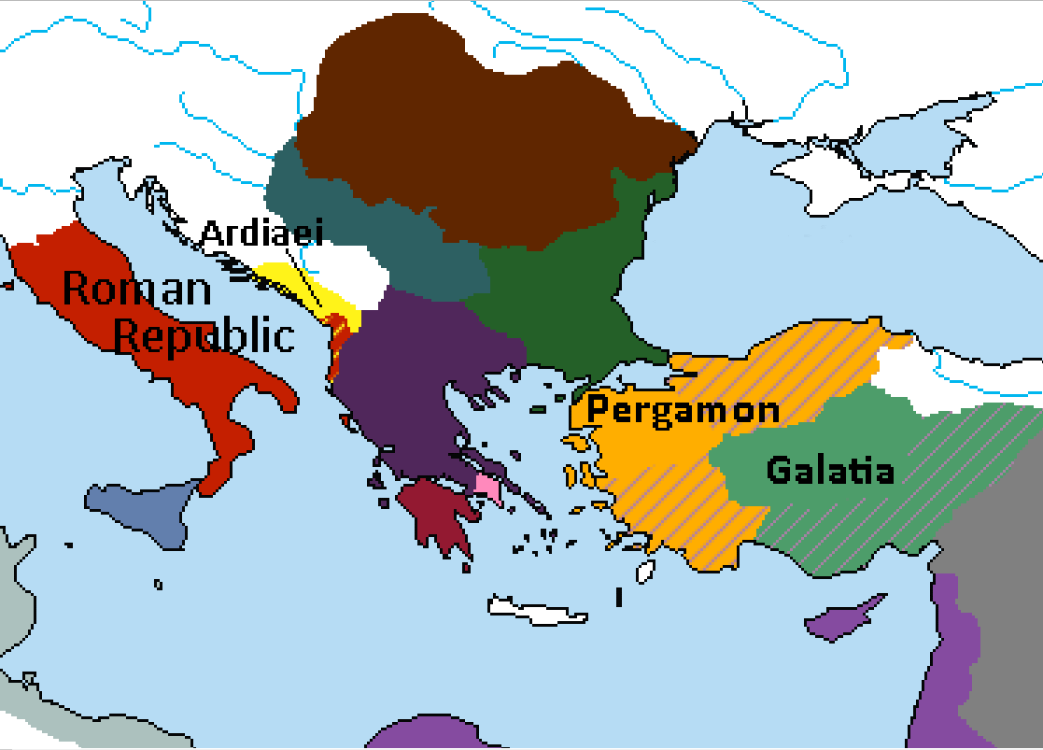
228 BCE
Attalus I Soter and his Galatian allies defeat Antiochus Hierax near Tarsus. Anatolia and Cilicia are divided between Attalus and his allies.
*In Illyria, Rome has landed in Apollonia and now besieges the Ardiaei capital of Shkodra.

Slide 39
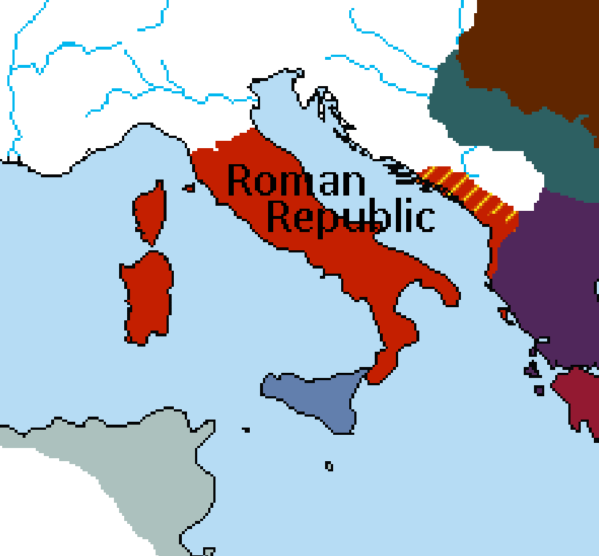
* “Illyria” here refers to the Kingdom of the Ardiaei; the rest of the Dalmatian coast and inlands are still largely under Celtic and Venetic influence.
**Sardinia and Corsica were annexed by Rome around 237 BCE after their rebellion from Carthage during the Mercenary War.
227 BCE
Queen Teuta of Illyria acknowledges Roman overlordship.
Illyria becomes a client kingdom of Rome.

Slide 40
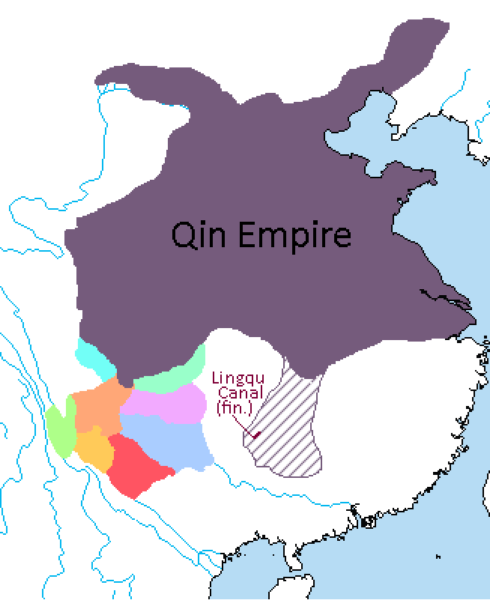
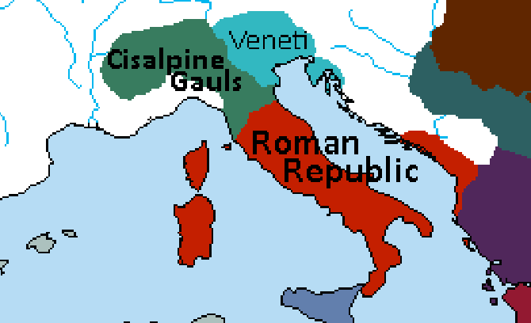
225 BCE
A renewed Qin offensive led by Wang Ben into Yue territory results in the completion of the Lingqu Canal. Wang Ben is made King of Lingling, which is incorporated into the Qin Empire.
*In Italy, a confederation of Gallic tribes crosses the Alps and pillages Roman settlements in Etruria. The Romans call on these Gauls’ historic enemies, the Veneti, and begin driving them towards the coast of Tuscany.

Slide 41
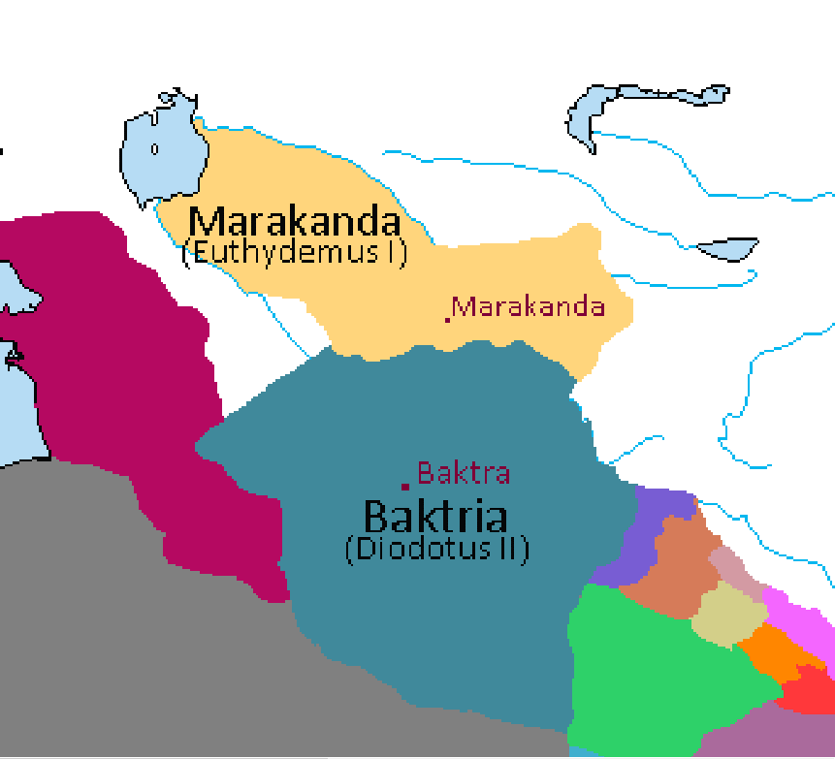
*Historically, Euthydemus kills Diodotus II in 225 BCE and succeeds him to the Baktrian throne. Considering it is Diodotus III who invades Marakanda 40 years later, it’s safe to assume Diodotus II is still alive at this point and will probably die in battle against Euthydemus in the near future.
**Also, the Aral Sea didn’t dry up until the Soviet era, please disregard any previous images showing modern sea levels.
223 BCE
Euthydemus I, Satrap of Sogdiana rebels against his Baktrian overlord Diodotus II, founding a great Hellenistic kingdom centered around Marakanda. Part of his army is composed of Helleno-Zhao troops.

Slide 42
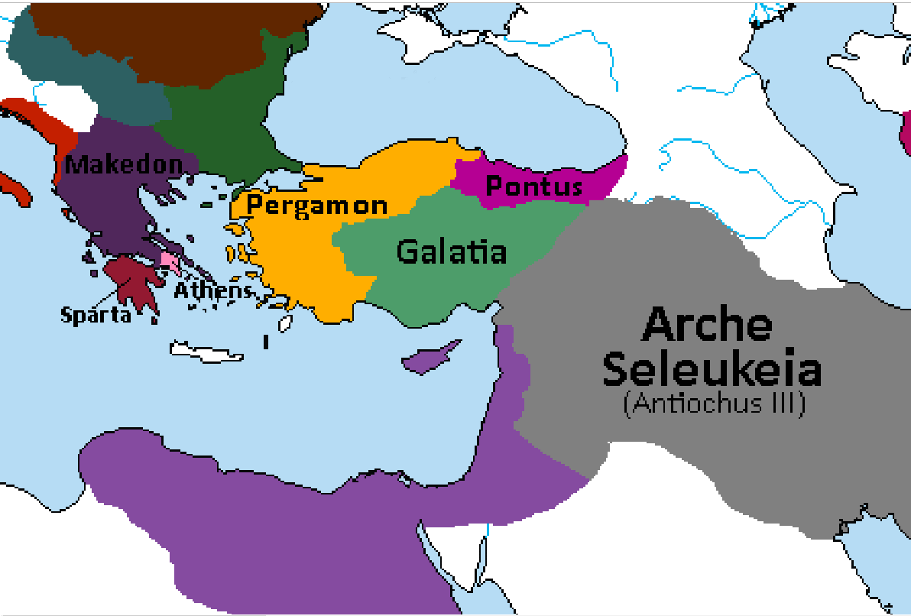
222 BCE
Antigonus III of Makedon attacks Athens but is defeated by a Spartan-Athenian coalition in the Second Battle of Marathon.
Antiochus III marries Laodice the daughter of Mithridates II of Pontus and an alliance is formed against Pergamon and the Galatians.

Slide 43
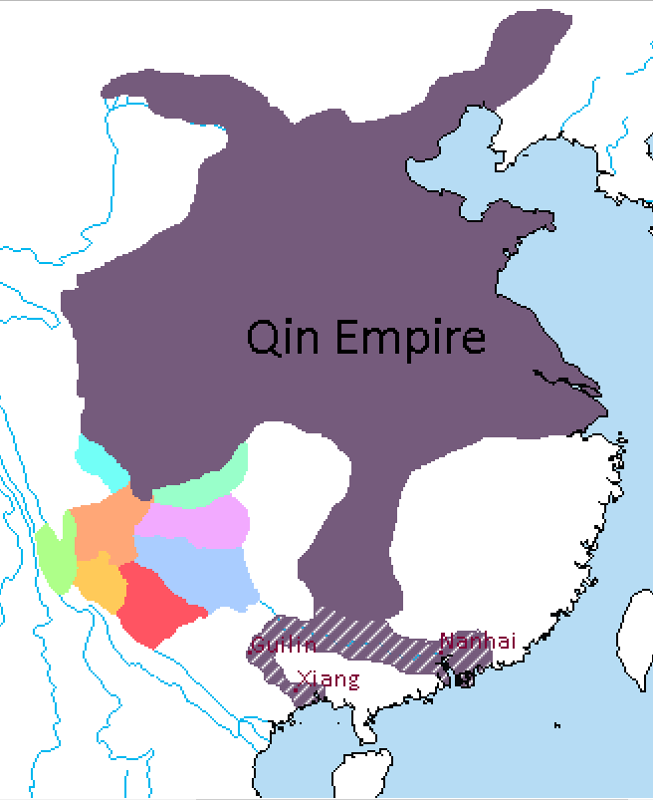
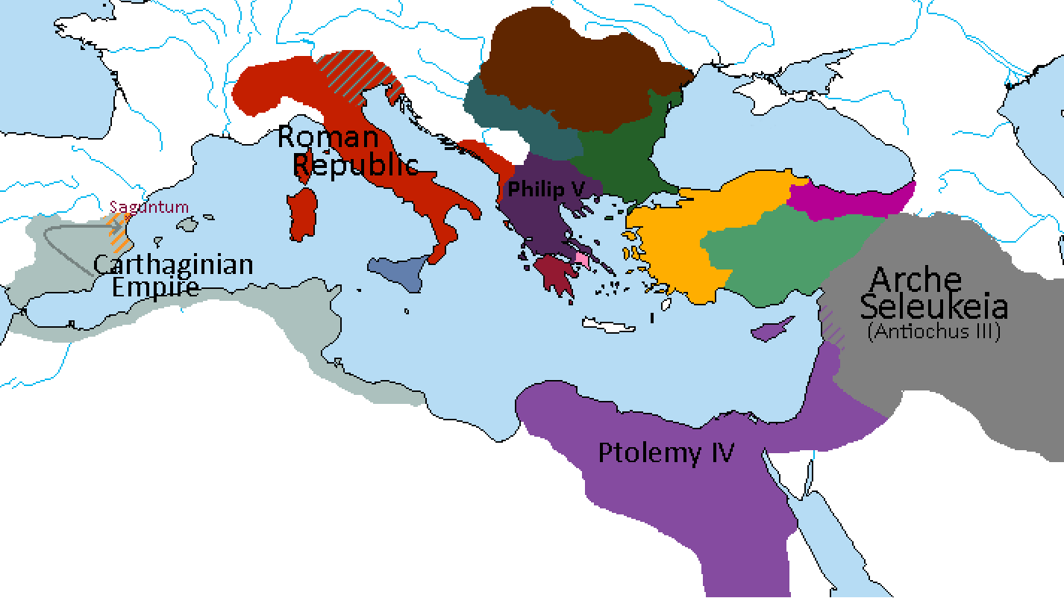
219 BCE
Hannibal besieges Saguntum, an ally of Rome. Beginning of the Second Punic War.
Qin forces expand into Guangdong. Nanhai Commandery is established with its capital at the mouth of the Pearl River.
Qin Shi Huang appoints his general Zhao Tuo as magistrate for the region.
*Ptolemy III Euergetes has been succeeded by Ptolemy IV, who is under complete influence of his regent Sosibus. Many of his own family are executed under his orders. He also marries his sister Arsinoe III.
**Antigonus III died in battle against the Illyrians and is succeeded by his cousin Philip V.
***Illyrians attack Roman settlements in Greece, triggering the Second Illyrian War. Rome’s interference here is the main cause of the First Makedonian War.
****Rome completes the conquest of the Veneti, leaving Liguria the only part of the Italian peninsula not under Roman control.
*****Antiochus III has successfully put down revolts in Mesopotamia and now turns his attention to Ptolemy IV’s lands in Syria. Beginning of the Fourth Syrian War.

Slide 44
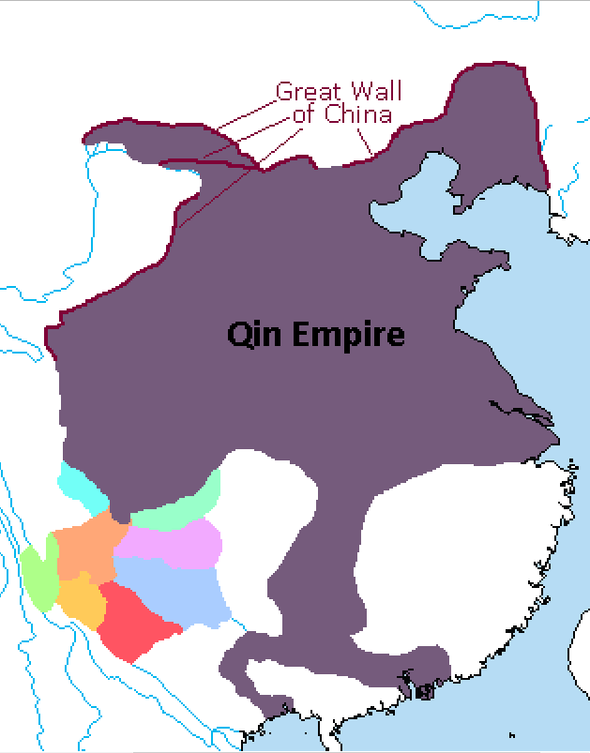
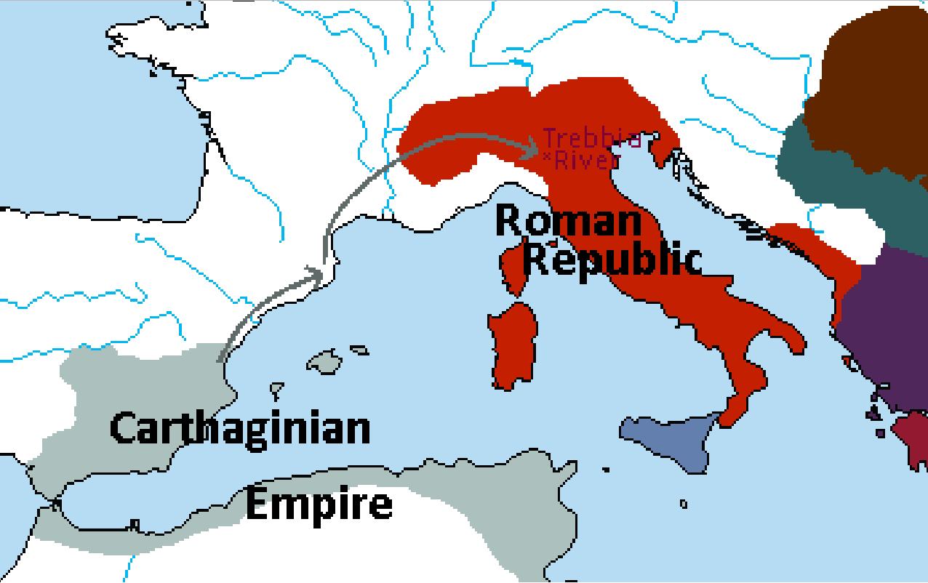
218 BCE
Qin Shi Huang orders the reconstruction of the Great Wall, surpassing the former in size.
*This is also when Hannibal’s legendary crossing of the Alps occurs, with 40,000 troops and 50 elephants attempting the trip. The same year (in winter no less) they arrive in the Po Valley and defeat the Romans at the Battle of the Trebia.

Slide 45
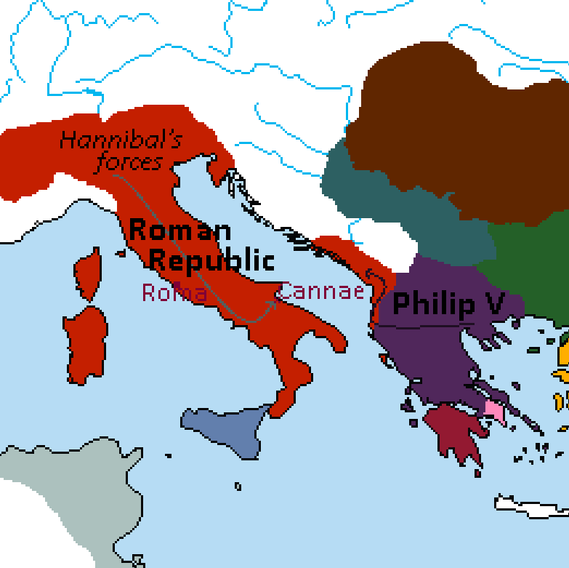
216 BCE
Philip V of Makedon invades the Roman client state of Illyria. Beginning of the First Makedonian War.
Hannibal defeats the Romans at Cannae.

Slide 46
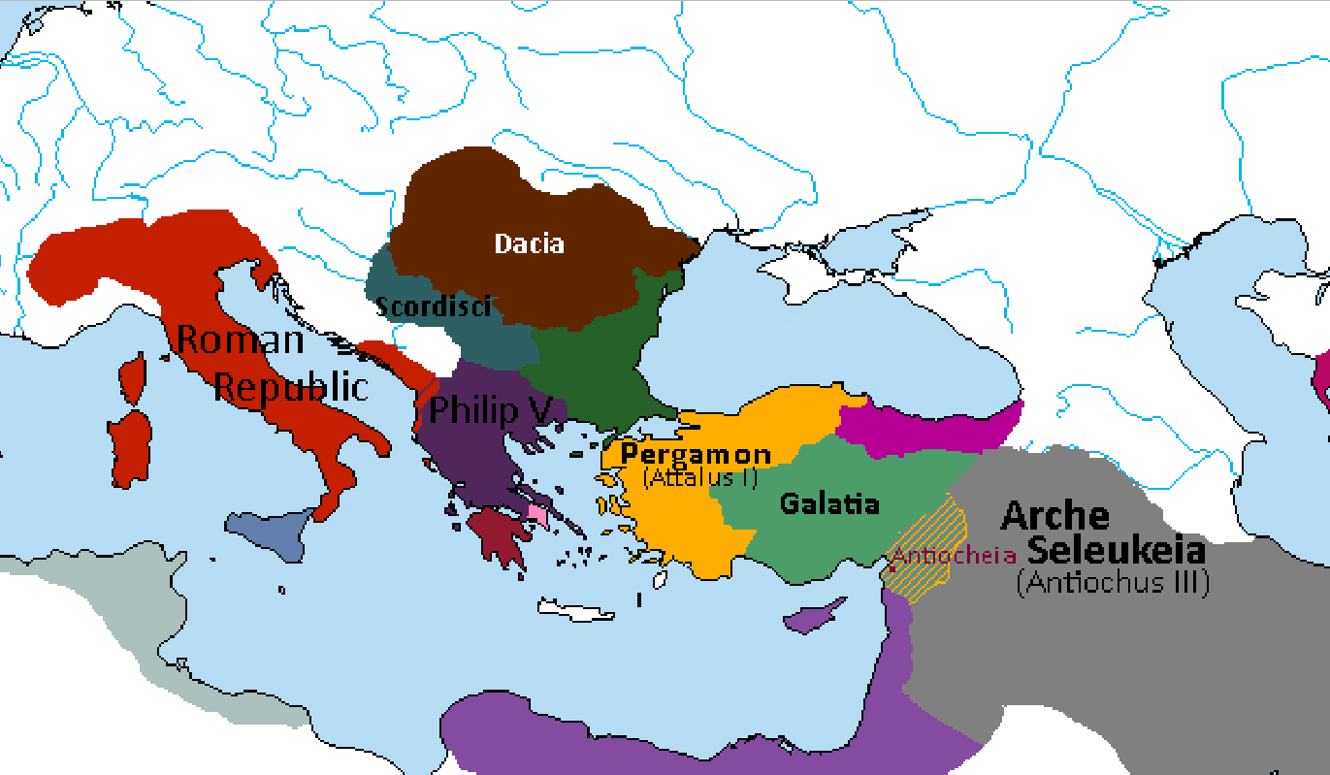
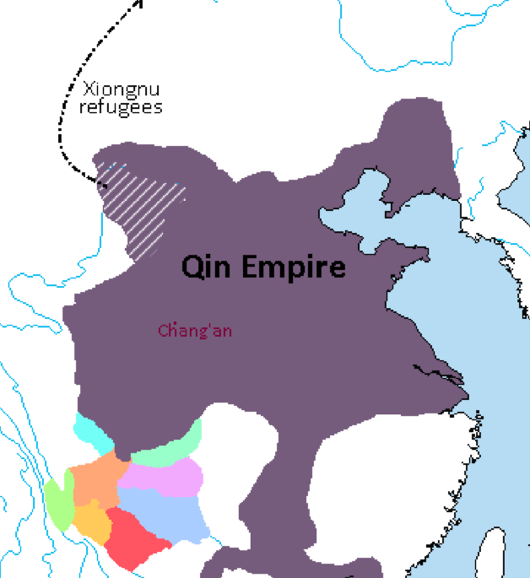
*At this time, Hannibal and Philip V have also made an alliance, although Hannibal reserves the right to make peace with Rome at any time in exchange for Makedonian sovereignty over Illyria as part of the negotiations.
**The Xiongnu will eventually consolidate into a confederation led by Modu Chanyu in 209 BCE.
***Qin Shi Huang constructs the Terracotta Army in Chang’an.
215 BCE
Attalus I Soter of Pergamon occupies Antiocheia. Antiochus III sues for peace and acknowledges Attalus's conquests and regains Antiocheia in the following peace treaty.
Philip V, with the help of his Dacian and Scordisci allies defeats a Roman army near Apollonia in Illyria.
A Qin army drives the Xiongnu from the Ordos Plateau. The refugees cross the Yellow River and move northward, reorganizing with other Xiongnu tribes in the area.

Slide 47

213 BCE
Qin Shi Huang orders all Confucian writings destroyed. Beginning of Legalist era in China, marked by absolute power invested in the head of state and the widespread persecution of scholars.
Renewed Chinese emigration to Hellenistic Central Asia as Confucian scholars find refuge in Marakanda.
Qin forces conquer the Luoyue kingdoms around the Red River Delta. Zhao Tuo is appointed King of Lingnan by Qin Shi Huang.
*The city of Panyu is founded near the mouth of the Pearl River.

